Slide 1
Introduction to Machine Learning

Slide 2
Learning
Agent has made observations (data)
Now must make sense of it (hypotheses)
Hypotheses alone may be important (e.g., in basic science)
For inference (e.g., forecasting)
To take sensible actions (decision making)
A basic component of economics, social and hard sciences, engineering, …

Slide 3
What is Learning?
Mostly generalization from experience:
“Our experience of the world is specific, yet we are able to formulate general theories that account for the past and predict the future” M.R. Genesereth and N.J. Nilsson, in Logical Foundations of AI, 1987
→ Concepts, heuristics, policies
Supervised vs. un-supervised learning

Slide 4
Topics in Machine Learning
Techniques Bayesian learning Decision trees Neural networks Support vector machines Boosting Case-based reasoning Dimensionality reduction …
Tasks & settings Classification Ranking Clustering Regression Decision-making Supervised Unsupervised Semi-supervised Active Reinforcement learning
Applications
Document retrieval
Document classification
Data mining
Computer vision
Scientific discovery Robotics …

Slide 5
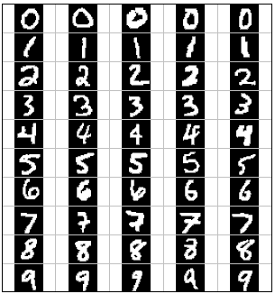
Supervised Learning
Agent is given a training set of input/output pairs (x,y), with y=f(x)
Task: build a model that will allow it to predict f(x) for a new x

Slide 6
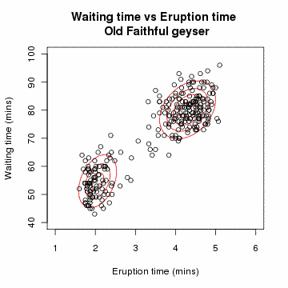
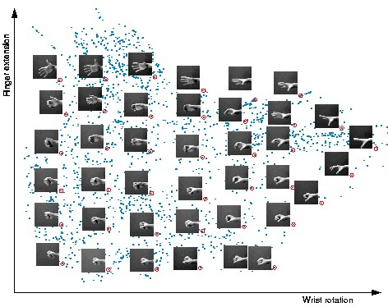
Unsupervised Learning
Agent is given a training set of data points x
Task: learn “patterns” in the data (e.g., clusters)

Slide 7
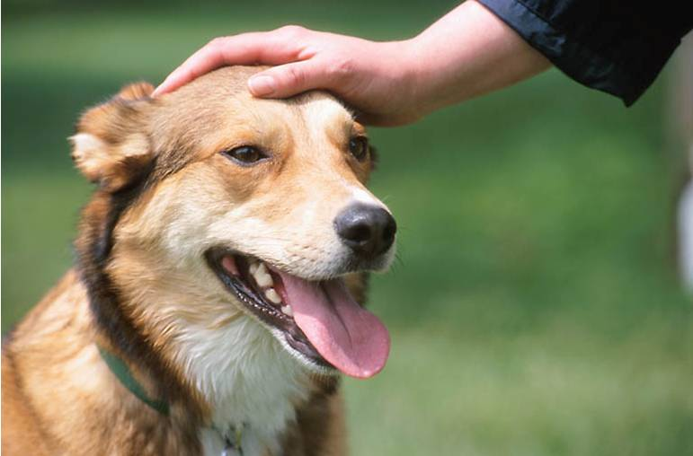
Reinforcement Learning
Agent acts sequentially in the real world, chooses actions a₁,…,a_{n}, receives reward R
Must decide which actions were most responsible for R

Slide 8
Other Variants
Semi-supervised learning
Some labels are given in the training set (usually a relatively small number)
Or, some labels are erroneous
Active (supervised) learning
Learner can choose which input points x to provide to an oracle, which will return the output y=f(x).

Slide 9
Deductive Vs. Inductive Reasoning
Deductive reasoning:
General rules (e.g., logic) to specific examples
Inductive reasoning:
Specific examples to general rules

Slide 10
Inductive Learning
Basic form: learn a function from examples
f is the unknown target function
An example is a pair (x, f(x))
Problem: find a hypothesis h
such that h ≈ f
given a training set of examples D
Instance of supervised learning
Classification task: f → {0,1,…,C} (usually C=1)
Regression task: f → reals

Slide 11
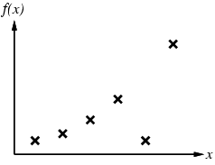
Inductive learning method
Construct/adjust h to agree with f on training set
(h is consistent if it agrees with f on all examples)
E.g., curve fitting:

Slide 12
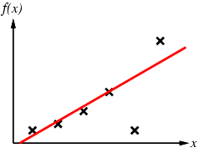
Inductive learning method
Construct/adjust h to agree with f on training set
(h is consistent if it agrees with f on all examples)
E.g., curve fitting:

Slide 13
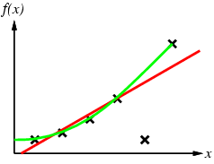
Inductive learning method
Construct/adjust h to agree with f on training set
(h is consistent if it agrees with f on all examples)
E.g., curve fitting:

Slide 14
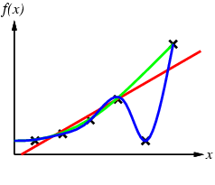
Inductive learning method
Construct/adjust h to agree with f on training set
(h is consistent if it agrees with f on all examples)
E.g., curve fitting:

Slide 15
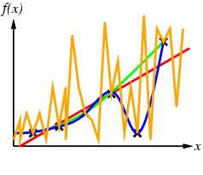
Inductive learning method
Construct/adjust h to agree with f on training set
(h is consistent if it agrees with f on all examples)
E.g., curve fitting:

Slide 16
Inductive learning method
Construct/adjust h to agree with f on training set
(h is consistent if it agrees with f on all examples)
E.g., curve fitting:
h=D is a trivial, but perhaps uninteresting solution (caching)

Slide 17
Classification Task
The target function f(x) takes on values True and False
A example is positive if f is True, else it is negative
The set X of all examples is the example set
The training set is a subset of X
a small one!

Slide 18
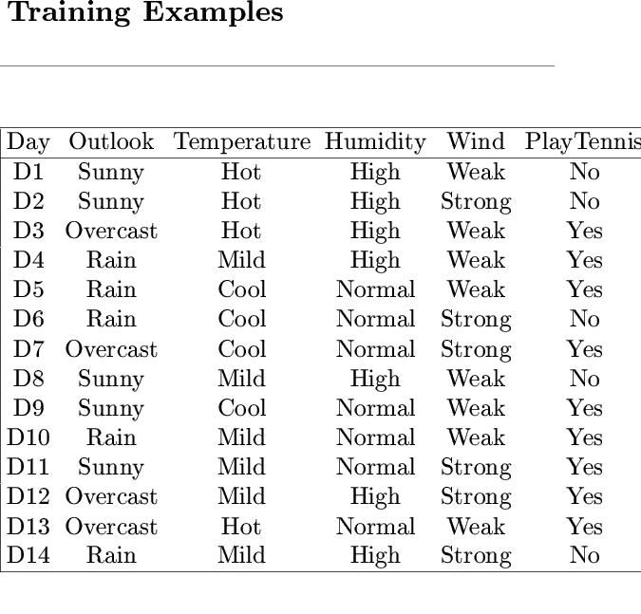
Logic-Based Inductive Learning
Here, examples (x, f(x)) take on discrete values

Slide 19
Logic-Based Inductive Learning
Here, examples (x, f(x)) take on discrete values
Concept
Note that the training set does not say whether
an observable predicate is pertinent or not

Slide 20
Rewarded Card Example
Deck of cards, with each card designated by [r,s], its rank and suit, and some cards “rewarded”
Background knowledge KB: ((r=1) v … v (r=10)) ⇔ NUM(r) ((r=J) v (r=Q) v (r=K)) ⇔ FACE(r) ((s=S) v (s=C)) ⇔ BLACK(s) ((s=D) v (s=H)) ⇔ RED(s)
Training set D: REWARD([4,C]) ∧ REWARD([7,C]) ∧ REWARD([2,S]) ∧ ¬REWARD([5,H]) ∧ ¬REWARD([J,S])

Slide 21
Rewarded Card Example
Deck of cards, with each card designated by [r,s], its rank and suit, and some cards “rewarded”
Background knowledge KB: ((r=1) v … v (r=10)) ⇔ NUM(r) ((r=J) v (r=Q) v (r=K)) ⇔ FACE(r) ((s=S) v (s=C)) ⇔ BLACK(s) ((s=D) v (s=H)) ⇔ RED(s)
Training set D: REWARD([4,C]) ∧ REWARD([7,C]) ∧ REWARD([2,S]) ∧ ¬REWARD([5,H]) ∧ ¬REWARD([J,S])
Possible inductive hypothesis: h ≡ (NUM(r) ∧ BLACK(s) ⇔ REWARD([r,s]))
There are several possible
inductive hypotheses

Slide 22
Learning a Logical Predicate (Concept Classifier)
Set E of objects (e.g., cards)
Goal predicate CONCEPT(x), where x is an object in E, that takes the value True or False (e.g., REWARD)
Observable predicates A(x), B(X), … (e.g., NUM, RED)
Training set: values of CONCEPT for some combinations of values of the observable predicates

Slide 23
Learning a Logical Predicate (Concept Classifier)
Set E of objects (e.g., cards)
Goal predicate CONCEPT(x), where x is an object in E, that takes the value True or False (e.g., REWARD)
Observable predicates A(x), B(X), … (e.g., NUM, RED)
Training set: values of CONCEPT for some combinations of values of the observable predicates
Find a representation of CONCEPT in the form: CONCEPT(x) ⇔ S(A,B, …) where S(A,B,…) is a sentence built with the observable predicates, e.g.: CONCEPT(x) ⇔ A(x) ∧ (¬B(x) v C(x))

Slide 24
Hypothesis Space
An hypothesis is any sentence of the form: CONCEPT(x) ⇔ S(A,B, …) where S(A,B,…) is a sentence built using the observable predicates
The set of all hypotheses is called the hypothesis space H
An hypothesis h agrees with an example if it gives the correct value of CONCEPT

Slide 25
Inductive Learning Scheme
Inductive hypothesis h
Training set D
-
-
-
+
+
-
-
-
-
+
+
+
+
-
-
+
+
+
+
-
-
-
+
+
Example set X
{[A, B, …, CONCEPT]}
Hypothesis space H
{[CONCEPT(x) ⇔ S(A,B, …)]}

Slide 26
Size of Hypothesis Space
n observable predicates
2^{n} entries in truth table defining CONCEPT and each entry can be filled with True or False
In the absence of any restriction (bias), there are
hypotheses to choose from
n = 6 → 2x10¹⁹ hypotheses!
2^{n}
2

Slide 27
Multiple Inductive Hypotheses
h₁ ≡ NUM(r) ∧ BLACK(s) ⇔ REWARD([r,s])
h₂ ≡ BLACK(s) ∧ ¬(r=J) ⇔ REWARD([r,s])
h₃ ≡ ([r,s]=[4,C]) ∨ ([r,s]=[7,C]) ∨ [r,s]=[2,S]) ⇔ REWARD([r,s])
h₄ ≡ ¬([r,s]=[5,H]) ∨ ¬([r,s]=[J,S]) ⇔ REWARD([r,s])
agree with all the examples in the training set

Slide 28
Multiple Inductive Hypotheses
Need for a system of preferences – called an inductive bias – to compare possible hypotheses
h₁ ≡ NUM(r) ∧ BLACK(s) ⇔ REWARD([r,s])
h₂ ≡ BLACK(s) ∧ ¬(r=J) ⇔ REWARD([r,s])
h₃ ≡ ([r,s]=[4,C]) ∨ ([r,s]=[7,C]) ∨ [r,s]=[2,S]) ⇔ REWARD([r,s])
h₄ ≡ ¬([r,s]=[5,H]) ∨ ¬([r,s]=[J,S]) ⇔ REWARD([r,s])
agree with all the examples in the training set

Slide 29
Notion of Capacity
It refers to the ability of a machine to learn any training set without error
A machine with too much capacity is like a botanist with photographic memory who, when presented with a new tree, concludes that it is not a tree because it has a different number of leaves from anything he has seen before
A machine with too little capacity is like the botanist’s lazy brother, who declares that if it’s green, it’s a tree
Good generalization can only be achieved when the right balance is struck between the accuracy attained on the training set and the capacity of the machine

Slide 30
→ Keep-It-Simple (KIS) Bias
Examples
Use much fewer observable predicates than the training set
Constrain the learnt predicate, e.g., to use only “high-level” observable predicates such as NUM, FACE, BLACK, and RED and/or to have simple syntax
Motivation
If an hypothesis is too complex it is not worth learning it (data caching does the job as well)
There are much fewer simple hypotheses than complex ones, hence the hypothesis space is smaller

Slide 31
→ Keep-It-Simple (KIS) Bias
Examples
Use much fewer observable predicates than the training set
Constrain the learnt predicate, e.g., to use only “high-level” observable predicates such as NUM, FACE, BLACK, and RED and/or to have simple syntax
Motivation
If an hypothesis is too complex it is not worth learning it (data caching does the job as well)
There are much fewer simple hypotheses than complex ones, hence the hypothesis space is smaller
Einstein: “A theory must be as simple as possible, but not simpler than this”

Slide 32
→ Keep-It-Simple (KIS) Bias
Examples
Use much fewer observable predicates than the training set
Constrain the learnt predicate, e.g., to use only “high-level” observable predicates such as NUM, FACE, BLACK, and RED and/or to have simple syntax
Motivation
If an hypothesis is too complex it is not worth learning it (data caching does the job as well)
There are much fewer simple hypotheses than complex ones, hence the hypothesis space is smaller
If the bias allows only sentences S that are
conjunctions of k << n predicates picked from the n observable predicates, then the size of
H is O(n^{k})

Slide 33
Predicate as a Decision Tree
The predicate CONCEPT(x) ⇔ A(x) ∧ (¬B(x) v C(x)) can
be represented by the following decision tree:
Example: A mushroom is poisonous iff it is yellow and small, or yellow,
big and spotted
x is a mushroom
CONCEPT = POISONOUS
A = YELLOW
B = BIG
C = SPOTTED
A?
True
False
B?
False
True
False
C?
True
True
False
True
False

Slide 34
Predicate as a Decision Tree
The predicate CONCEPT(x) ⇔ A(x) ∧ (¬B(x) v C(x)) can
be represented by the following decision tree:
Example: A mushroom is poisonous iff it is yellow and small, or yellow,
big and spotted
x is a mushroom
CONCEPT = POISONOUS
A = YELLOW
B = BIG
C = SPOTTED
D = FUNNEL-CAP
E = BULKY
A?
True
False
B?
False
True
False
C?
True
True
False
True
False

Slide 35
Training Set
Ex. # | A | B | C | D | E | CONCEPT
1 | False | False | True | False | True | False
2 | False | True | False | False | False | False
3 | False | True | True | True | True | False
4 | False | False | True | False | False | False
5 | False | False | False | True | True | False
6 | True | False | True | False | False | True
7 | True | False | False | True | False | True
8 | True | False | True | False | True | True
9 | True | True | True | False | True | True
10 | True | True | True | True | True | True
11 | True | True | False | False | False | False
12 | True | True | False | False | True | False
13 | True | False | True | True | True | True

Slide 36
Possible Decision Tree
D
T
F
E
C
A
T
B
F
T
F
T
E
A
A
F
T
T
F

Slide 37
Possible Decision Tree
CONCEPT ⇔
(D∧(¬EvA))v(¬D∧(C∧(Bv(¬B∧((E∧¬A)v(¬E∧A))))))
D
T
F
E
C
CONCEPT ⇔ A ∧ (¬B v C)
T
F
A
B
A?
True
False
T
F
T
E
B?
False
True
False
C?
True
A
A
True
False
True
False
F
T
T
F

Slide 38
Possible Decision Tree
CONCEPT ⇔
(D∧(¬EvA))v(¬D∧(C∧(Bv(¬B∧((E∧¬A)v(¬E∧A))))))
D
T
F
E
C
CONCEPT ⇔ A ∧ (¬B v C)
T
F
A
B
A?
True
False
KIS bias → Build smallest decision tree
T
F
T
E
B?
False
True
False
C?
True
A
A
Computationally intractable problem → greedy algorithm
True
False
True
False
F
T
T
F

Slide 39
Getting Started: Top-Down Induction of Decision Tree
The distribution of training set is:
True: 6, 7, 8, 9, 10,13
False: 1, 2, 3, 4, 5, 11, 12
Ex. # | A | B | C | D | E | CONCEPT
1 | False | False | True | False | True | False
2 | False | True | False | False | False | False
3 | False | True | True | True | True | False
4 | False | False | True | False | False | False
5 | False | False | False | True | True | False
6 | True | False | True | False | False | True
7 | True | False | False | True | False | True
8 | True | False | True | False | True | True
9 | True | True | True | False | True | True
10 | True | True | True | True | True | True
11 | True | True | False | False | False | False
12 | True | True | False | False | True | False
13 | True | False | True | True | True | True

Slide 40
Getting Started: Top-Down Induction of Decision Tree
The distribution of training set is:
True: 6, 7, 8, 9, 10,13
False: 1, 2, 3, 4, 5, 11, 12
Without testing any observable predicate, we
could report that CONCEPT is False (majority rule) with an estimated probability of error P(E) = 6/13
Assuming that we will only include one observable
predicate in the decision tree, which predicate should we test to minimize the probability of error (i.e., the # of misclassified examples in the training set)? → Greedy algorithm

Slide 41
Suppose we pick A
A
T
F
True:
False:
6, 7, 8, 9, 10, 13
11, 12
1, 2, 3, 4, 5
If we test only A, we will report that CONCEPT is True if A is True (majority rule) and False otherwise
→ The number of misclassified examples from the training set is 2

Slide 42
Suppose we pick B
B
T
F
True:
False:
9, 10
2, 3, 11, 12
6, 7, 8, 13
1, 4, 5
If we test only B, we will report that CONCEPT is False if B is True and True otherwise
→ The number of misclassified examples from the training set is 5

Slide 43
Suppose we pick C
C
T
F
True:
False:
6, 8, 9, 10, 13
1, 3, 4
7
1, 5, 11, 12
If we test only C, we will report that CONCEPT is True if C is True and False otherwise
→ The number of misclassified examples from the training set is 4

Slide 44
Suppose we pick D
D
T
F
True:
False:
7, 10, 13
3, 5
6, 8, 9
1, 2, 4, 11, 12
If we test only D, we will report that CONCEPT is True if D is True and False otherwise
→ The number of misclassified examples from the training set is 5

Slide 45
Suppose we pick E
E
T
F
True:
False:
8, 9, 10, 13
1, 3, 5, 12
6, 7
2, 4, 11
If we test only E we will report that CONCEPT is False,
independent of the outcome
→ The number of misclassified examples from the training set is 6

Slide 46
Suppose we pick E
E
T
F
True:
False:
8, 9, 10, 13
1, 3, 5, 12
6, 7
2, 4, 11
So, the best predicate to test is A
If we test only E we will report that CONCEPT is False,
independent of the outcome
→ The number of misclassified examples from the training set is 6

Slide 47
Choice of Second Predicate
A
T
F
C
False
F
T
True:
False:
6, 8, 9, 10, 13
7
11, 12
→ The number of misclassified examples from the training set is 1

Slide 48
Choice of Third Predicate
A
T
F
C
False
F
T
True
B
T
F
True:
False:
11,12
7

Slide 49
Final Tree
A
A?
True
False
True
False
C
False
B?
False
True
False
True
False
B
C?
True
True
True
False
True
False
True
False
False
True
CONCEPT ⇔ A ∧ (C v ¬B)
CONCEPT ⇔ A ∧ (¬B v C)

Slide 50
Top-Down Induction of a DT
A
True
False
C
False
True
False
True
B
True
False
DTL(Δ, Predicates)
If all examples in Δ are positive then return True
If all examples in Δ are negative then return False
If Predicates is empty then return failure
A ← error-minimizing predicate in Predicates
Return the tree whose:
- root is A,
- left branch is DTL(Δ^{+A},Predicates-A),
- right branch is DTL(Δ^{-A},Predicates-A)
False
True
Subset of examples that satisfy A

Slide 51
Top-Down Induction of a DT
A
True
False
C
False
True
False
True
B
True
False
DTL(Δ, Predicates)
If all examples in Δ are positive then return True
If all examples in Δ are negative then return False
If Predicates is empty then return failure
A ← error-minimizing predicate in Predicates
Return the tree whose:
- root is A,
- left branch is DTL(Δ^{+A},Predicates-A),
- right branch is DTL(Δ^{-A},Predicates-A)
False
True
Noise in training set!
May return majority rule, instead of failure

Slide 52
Comments
Widely used algorithm
Greedy
Robust to noise (incorrect examples)
Not incremental (need entire training set at once)

Slide 53
Learnable Concepts
Some simple concepts cannot be represented compactly in DTs
Parity(x) = X₁ xor X₂ xor … xor X_{n}
Majority(x) = 1 if most of X_{i}’s are 1, 0 otherwise
Exponential size in # of attributes
Need exponential # of examples to learn exactly
The ease of learning is dependent on shrewdly (or luckily) chosen attributes that correlate with CONCEPT

Slide 54
Applications of Decision Tree
Medical diagnostic / Drug design
Evaluation of geological systems for assessing gas and oil basins
Early detection of problems (e.g., jamming) during oil drilling operations
Automatic generation of rules in expert systems

Slide 55
Human-Readability
DTs also have the advantage of being easily understood by humans
Legal requirement in many areas
Loans & mortgages
Health insurance
Welfare

Slide 56
Capacity is Not the Only Criterion
Accuracy on training set isn’t the best measure of performance
Training set D
-
-
-
+
+
-
-
-
-
Test
+
+
+
+
-
-
+
+
Learn
+
+
-
-
-
+
+
Example set X
Hypothesis space H

Slide 57
Generalization Error
A hypothesis h is said to generalize well if it achieves low error on all examples in X
-
-
Test
-
+
+
-
-
-
-
+
+
+
+
-
-
Learn
+
+
+
+
-
-
-
+
+
Example set X
Hypothesis space H

Slide 58
Assessing Performance of a Learning Algorithm
Samples from X are typically unavailable
Take out some of the training set
Train on the remaining training set
Test on the excluded instances
Cross-validation

Slide 59
Cross-Validation
Split original set of examples, train
Examples D
-
+
-
-
+
-
-
-
-
+
+
+
+
-
-
+
Train
+
+
+
-
-
-
+
+
Hypothesis space H

Slide 60
Cross-Validation
Evaluate hypothesis on testing set
Testing set
-
-
-
-
+
+
+
+
+
+
-
-
+
Hypothesis space H

Slide 61
Cross-Validation
Evaluate hypothesis on testing set
Testing set
-
+
+
-
+
+
+
Test
-
+
+
-
-
-
Hypothesis space H

Slide 62
Cross-Validation
Compare true concept against prediction
9/13 correct
Testing set
-
-
-
+
-
+
-
-
+
+
+
+
+
+
+
-
+
+
+
+
-
-
-
-
+
-
Hypothesis space H

Slide 63
Tennis Example
Evaluate learning algorithm PlayTennis = S(Temperature,Wind)

Slide 64
Tennis Example
Evaluate learning algorithm PlayTennis = S(Temperature,Wind)
Trained hypothesis
PlayTennis = (T=Mild or Cool) ∧ (W=Weak)
Training errors = 3/10
Testing errors = 4/4

Slide 65
Tennis Example
Evaluate learning algorithm PlayTennis = S(Temperature,Wind)
Trained hypothesis
PlayTennis = (T=Mild or Cool)
Training errors = 3/10
Testing errors = 1/4

Slide 66
Tennis Example
Evaluate learning algorithm PlayTennis = S(Temperature,Wind)
Trained hypothesis
PlayTennis = (T=Mild or Cool)
Training errors = 3/10
Testing errors = 2/4

Slide 67
Ten Commandments of machine learning
Thou shalt not:
Train on examples in the testing set
Form assumptions by “peeking” at the testing set, then formulating inductive bias

Slide 68
Supervised Learning Flow Chart
Datapoints
Target function
Unknown concept we want to approximate
Training
set
Hypothesis space
Learner
Choice of learning algorithm
Observations we have seen
Inductive Hypothesis
Test set
Better quantities to assess performance
Prediction
Observations we will see in the future

Slide 69
Key Ideas
Different types of machine learning problems
Supervised vs. unsupervised
Inductive bias (keep it simple)
Decision trees
Assessing learner performance
Generalization
Cross-validation

Slide 70
Next Time
More decision tree learning, ensemble learning
R&N 18.1-3

